Slide 1

Analysis of your SQL Server like a PRO
Uwe Ricken
https://t1p.de/SQLAnalysis

Slide 2




Uwe Ricken db Berater GmbH
I am working with IT-systems since early 1990's and with the main focus on Microsoft SQL Server since version 6.0. I started with development of database applications in 1998 with a professional CRM-System based on Microsoft products (Microsoft Office and Microsoft SQL Server).
Since 2008 I'm focused exclusively on Microsoft SQL Server and since 2008 I'm working in 3rd level support teams for banks, insurances and global industries.
Since May 2013 I'm a Microsoft Certified Master: SQL Server 2008 which was an amazing way into the depth of Microsoft SQL Server.
In July 2013 I have been awarded with the MVP Award for Microsoft SQL Server.
www: http://www.db-berater.de
email: uwe.ricken@db-berater.de
blog: http://www.sqlmaster.de
twitter: @dbberater
xing: http://www.xing.com/profile/Uwe_Ricken

Slide 3
Break Times
09:00 – 10:30 Session
10:30 – 11:00 Coffee Break (and fresh air – smoking ☺ )
11:00 – 12:30 Session
12:30 – 13:30 Lunch Break
13:30 – 15:00 Session
15:00 – 15:30 Coffee Break
15:30 – 16:45 / 17:00 Session

Slide 4
Who wants to run an analysis of Microsoft SQL Server?
Consultant
Approval of a system which has been installed by vendors
Analysis of Problems
Analysis for Optimization
DBA
Analysis of Problems
Analysis for Optimization (well, not really but…)

Slide 5
Agenda
Operating System
Generic Information about the installed Microsoft SQL Server 001 - A00 - System Environment - Generic Information.sql
Check of the system environment of the service account 001 - A01 - System Environment - Security of service account.sql
Formatted block size of the storage 001 - A01 - System Environment - Security of service account.sql
Security check for the service account 001 - A01 - System Environment - Security of service account.sql
System configuration
CPU / RAM / IO 001 - A00 - System Environment - Generic Information.sql 001 - A02 - System Environment - Drive Latency.sql

Slide 6
Agenda
SQL Server Configuration and Resource-Usage 001 - A03 - System Environment - Drive Latency.sql 001 - A04 - System Environment - Configuration.sql 001 - A05 - System Environment - Page Life Expectancy.sql
How about the SQL Server Agent Jobs 001 - A06 - System Environment - SQL Agent Job Information.sql
Database configuration 002 - A01 - Database analysis - Distribution of databases.sql 002 - A02 - Database analysis - Database size and consumption.sql 002 - A03 - Database analysis - Database Settings.sql 002 - A04 - Database analysis - Bufferpool usage.sql 003 - A01 - TEMPDB analysis - data file information.sql
Backup 001 - A07 - System Environment - Backup-Information.sql

Slide 7
Agenda
Wait Stats 004 - A01 - What tasks are CURRENTLY waiting.sql 004 - A02 - Waiting - Analysis of wait stats.sql
Indexes and Statistics 005 - A01 - Index usage in dedicated database.sql 005 - A02 - Index physical stats in dedicated database.sql 005 - A04 - Missing Indexes and its impact.sql 005 - A03 - Statistics in explicit database.sql
Plan Cache Analysis 005 - A05 - Analyze of the plan cache.sql 005 - A06 - find CXPACKET queries in the plan cache.sql

Slide 8

Let‘s go diving…
Learn to dive in a shallow environment and get deeper into the infinite settings and configuration options of Microsoft SQL Server

Slide 9
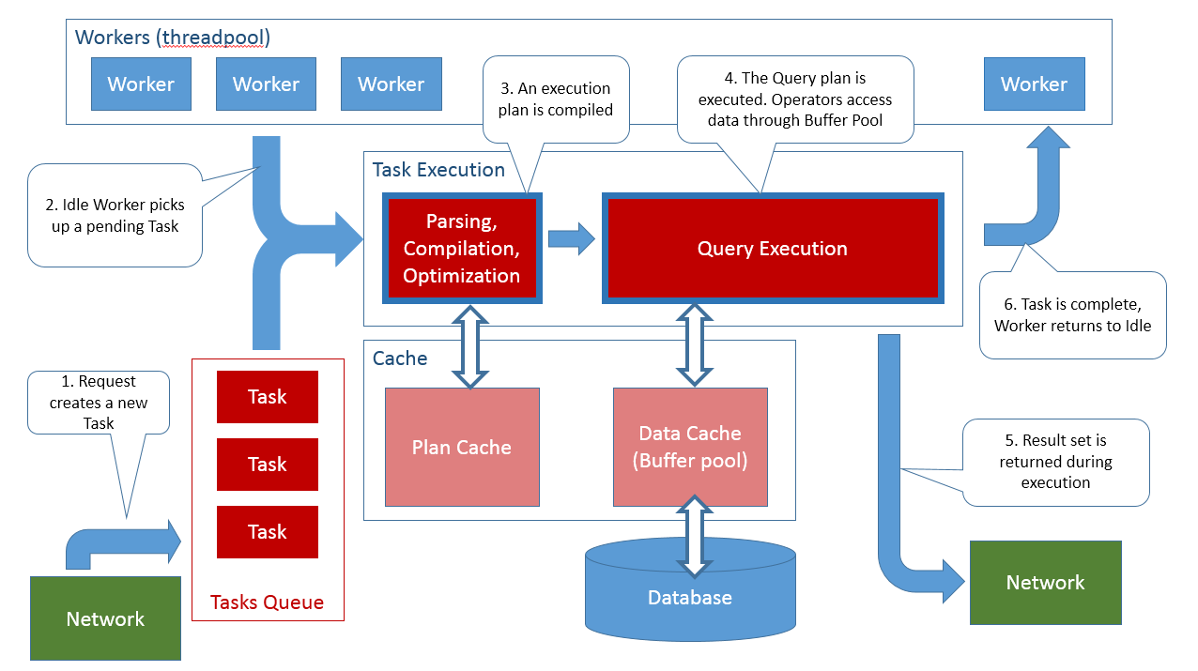
Workflow of a Database Request
Threadpool
Depiction: http://rusanu.com/2013/08/01/understanding-how-sql-server-executes-a-query/

Slide 10
Investigating the Operating System
Physical / Virtual Environment
How many CORES / RAM?
Does the system have multiple disks present?
What is the block size of the storage?
Is Instant File Initialization enabled for the service account?

Slide 11
Environment of Microsoft SQL Server
How much RAM does Microsoft SQL Server use?
Can Microsoft SQL Server use all CPU Cores?
What Security Model is configured?
Windows Authentication
Mixed Authentication
Are the following trace flags enabled (not for SQL Server >=2016!)
TF 1117: all files of a file group grow at the same time
TF 1118: disable usage of mixed extents
TF 2371: change the threshold for statistics update
Advanced configuration options
Max Degree of Parallelism
Cost Threshold for Parallelism
AdHoc Workloads

Slide 12
NUMA-Nodes

Slide 13
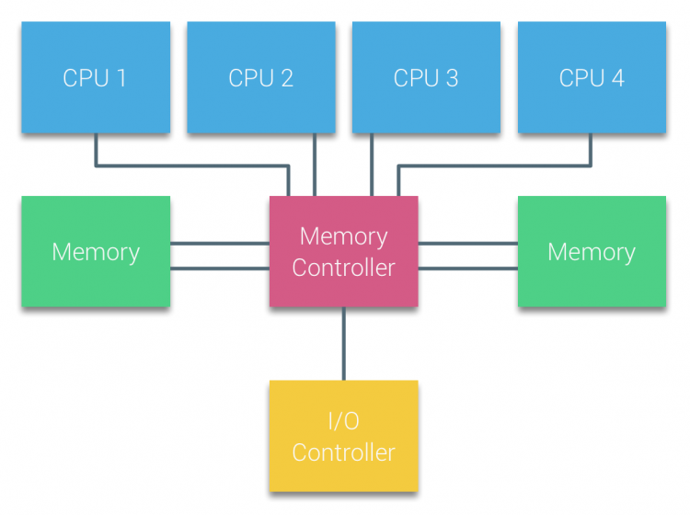
(N)UMA Configuration

Slide 14
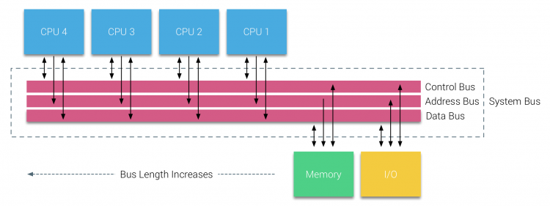
(N)UMA Configuration

Slide 15
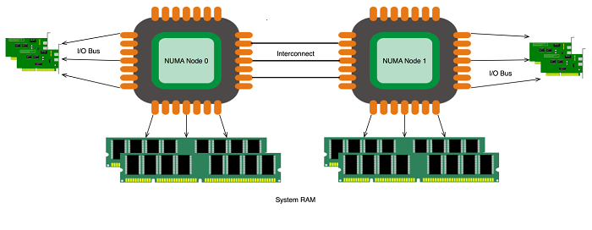
NUMA Configuration

Slide 16
Why to use additional Traceflags
TF: 1117
TF: 1118
TF: 2371

Slide 17
Database structures
Datenbank
System- und User data will be stored in data pages.
Every data page has a fixed size of 8.192 Bytes:
96 Bytes for the Page Header
8.060 Bytes for data
36 Bytes for the Slot-Array
8 continuous data pages will be stored in an extent:
Mixed Extents can store data from different objects
Uniform Extents store data from only ONE object
System relevant Data Pages:
PFS (Page Free Space):
SGAM (Shared Global Allocation Map):
GAM (Global Allocation Map):
IAM (Index Allocation Map):
112
113
114
115
116
117
118
119

Slide 18
Traceflag 1117
Trace flag 1117 changes the behavior of file growth: if one data file in a filegroup grows, it forces other files in that filegroup to grow, too
Useful for tempdb, which is commonly configured with multiple data files
Trace Flag 1117 is recommended in the Fast Track Architecture Guide from Microsoft.

Slide 19
TF 1118
TF 1118 avoid “mixed extents” and use “full extents”.
Each newly allocated object in every database gets its own 64KB of data.
It makes the most difference in system database TEMPDB.

Slide 20
MIXED Extents
Mixed Extents store data from different objects
Table 1
Table 2
Table 3
Table 4
MIXED Extent
105 | 106 | 107 | 108 | 109 | 110 | 111 | 112

Slide 21
UNIFORM Extents
Uniform Extents store data of a single object
Table 1
Table 2
Table 3
Table 4
MIXED Extent
105 | 106 | 107 | 108 | 109 | 110 | 111 | 112
MIXED Extent
113 | 114 | 115 | 116 | 117 | 118 | 119 | 120
UNIFORM Extent
121 | 122 | 123 | 124 | 125 | 126 | 127 | 128

Slide 22
Database Configuration

Slide 23
Configuration of Databases
How are databases distributed on the disks?
Segregation of DATA und LOG?
What is the default value for the Growth of a database?
What is the size of the databases?
What space is available in the database?
What is the recovery model?
…

Slide 24
Configuration of Databases
Configure your database with a sufficient initial size (we recommend at least 1.024 MB)
make sure that the growth value is also sufficiently dimensioned (we start with at least 1.024 MB) but we have customers with an autogrowth value for their databases of 102.400 MB
If your database has multiple files in ONE filegroup, make sure that all files have the same size and same autogrowth value configured
If you run SQL Server before 2016, activate TF 1117 for an automatic growth of all files in ONE filegroup at the same time!

Slide 25
System Database TempDB

Slide 26
Vulnerability: TEMPDB
Usage patterns for TEMPDB
READ COMMITTED SNAPSHOT ISOLATION
HASH- /SORT-Operations
User defined temporary Tables
Table variables
…
All operations want to allocate space in TEMPDB
Reservation / Contention of PFS / GAM / SGAM

Slide 27
TempDB best practice
Place TEMPDB on its own drive
Format the drive with at least 64 KBytes
Have multiple files for TEMPDB
<=8 Cores: 1 File / Core
> 8 Cores: 8 Files*
All files are configured with the same size and autogrowth value
Use 80% of your available disk space for the initial size of the TEMPDB files
The Log File does not need a separate drive!
If you run SQL Server before 2016, make sure that TF 1118 is enabled!
* If you detect Latch Contention on TEMPDB system pages (PFS, SGAM, GAM) add more files to TEMPDB until the Latch Contention stops

Slide 28
When SQL Server has to wait
Wait Stats Analysis

Slide 29
When SQL Server has to wait!
running
60: RUNNING
55: RUNNABLE 59: RUNNABLE
72: RUNNABLE
51: RUNNABLE
54: WAITFOR
56: ASYNC_...
68: LCK_M_S
70: PAGELA..
runnable
suspended

Slide 30
When SQL Server has to wait!
running
55: RUNNING >4ms
59: RUNNABLE
72: RUNNABLE
51: RUNNABLE
68: RUNNABLE
54: WAITFOR
56: ASYNC_...
70: PAGELA..
runnable
suspended

Slide 31
When SQL Server has to wait!
running
59: RUNNING
Quantum: 4ms SOS_SCHEDULER_YIELD
72: RUNNABLE
51: RUNNABLE
68: RUNNABLE
55: RUNNABLE
54: WAITFOR
56: ASYNC_...
70: PAGELA..
runnable
suspended

Slide 32
Index Maintenance
Speed up your indexes

Slide 33
Index and Statistics Maintenance
Indexes are important for the performance of your queries
Consider the workloads for a good maintenance balance!
Does the application read data heavily
Does the application write data heavily
Check the index usage stats to get a picture of the workloads
Without maintained statistics a bad execution plan can be used by Microsoft SQL Server
Use the scripts from Ola Hallengren (https://ola.Hallengren.com) for a periodically index and statistics maintenance
With Microsoft SQL Server 2016 you can use maintenance plans, too

Slide 34
Anatomy of Heaps
IAM 110 123 150 …
L 110
L 123
L 150
L 151
L 152
L 152
L 152
L 152
L 152
L 152

Slide 35
Heaps: Forwarded Records
IAM
119
121
126
127
142
156
The IAM page will be read first to know which data pages belong to the heap!
Record on page 119 points to page 156 (forwarded record)
After page 156 has been read the read process will get back to page 119
Reading pages 121, 126, 127, 142, 156
Page 156 will be read 2x!
1
119
1 = 156 2 3 4
121
5 6 7 8
126
9 10 11 12
127
13 14 15 16
142
17 18 19 20
156
1
3
4
5
6
7
2

Slide 36
Anatomy of an Index
Order_Id
1 – 1.000.000
Level 2
Order_Id 1 – 500.000
Order_Id 500.001 – 1.000.000
Level 1
Orders 1 – 50
Orders 51 - 100
Orders 101 - 150
Orders 500.001 - …
Orders …
Orders …
Level 0

Slide 37
Anatomy of an index
Order_Id
1 – 1.000.000
Level 2
Order_Id 1 – 500.000
Order_Id 500.001 – 1.000.000
Level 1
Orders 1 – 50
Orders 51 - 100
Orders 101 - 150
Orders 500.001 - …
Orders …
Orders …
Level 0

Slide 38
Index: Page Split
Orders 1 – 50
Orders 51 - 100
Orders 101 - 150
Orders 500.001 - …
Orders …
UPDATE dbo.Orders SET Order Text = 'A very long Text' WHERE Order_Id = 37;
Orders 1 – 36
Orders 51 - 100
Orders 101 - 150
Orders 500.001 - …
Orders …
Orders 37 - 50

Slide 39
Documentation
Start with a short introduction of your person!
Describe the reason for the preparation of the report
Problems, which – suddenly – occurred?
Baseline before a Go Live?
Inform the reader that no Hardware investigation has been done when you do not have access to the hardware
Define a structure of the document which is correlating to your investigation steps!

Slide 40
Table of Content
Technical Configuration
Hardware / Virtualization
Windows OS
Microsoft SQL Server
Results of investigation
OS / Storage / RAM / NUMA
Microsoft SQL Server
Cost Threshold for Parallelism / Max Degree of Wait Stats / AdHoc queries
Wait Stats
Databases
Indexes / Statistics
Recommendation
For each „finding“ a dedicated chapter with reference to the finding

Slide 41
Any Questions?

Slide 42


Slide 43
Thank you

